Slide 1
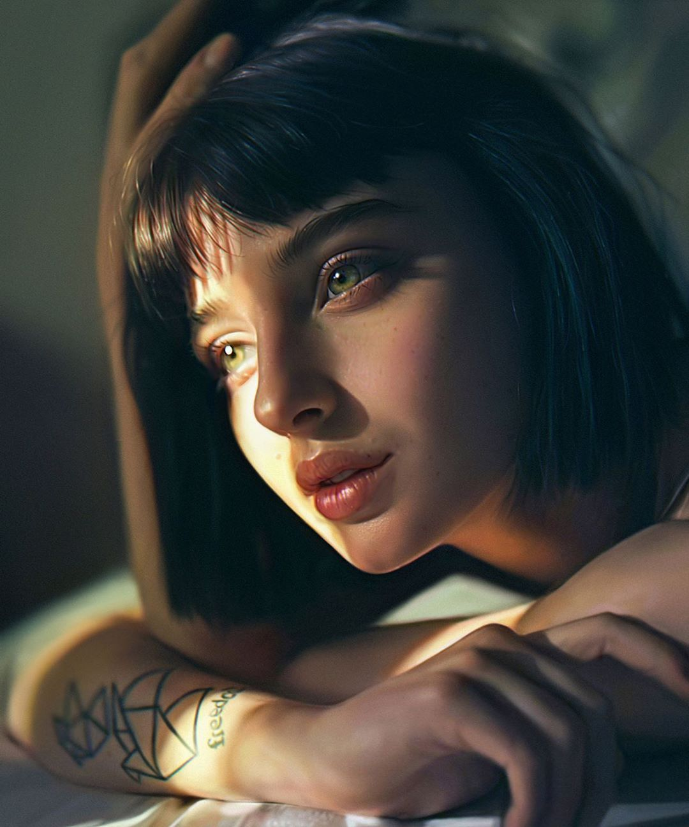
MORI
MOTO
MINIMAL PRESENTATION
-2021

Slide 2
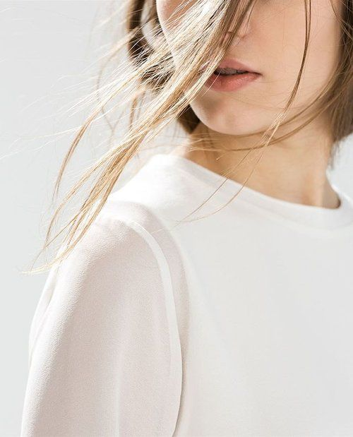
Create New
Concept
A designer who has served the industry for over a decade.
Original~
Design has the power to pull people closer, guiding them visually so they can easily engage with your brand. It replaces confusion with clarity and brings understanding to those who encounter your work.
Design to enhance everyday life.

Slide 3
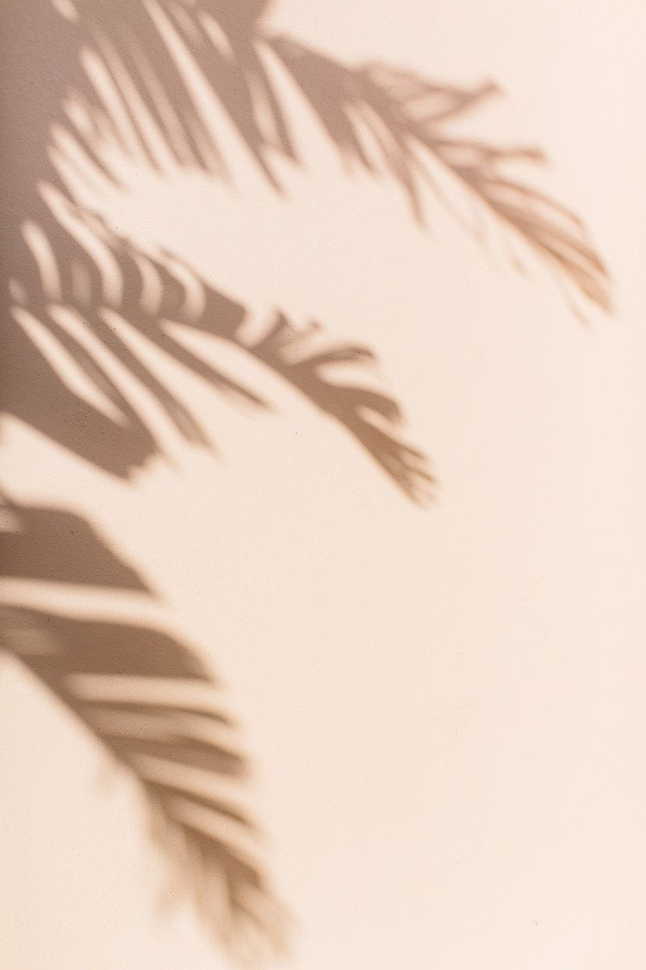
Design to enhance everyday life.
Hidden power from inside.
Original~
For some professionals, this priority can take its toll as it removes the heart and soul from the design process:
These employees experienced lower job satisfaction and had a negative outlook on their prospects of career progression.

Slide 4
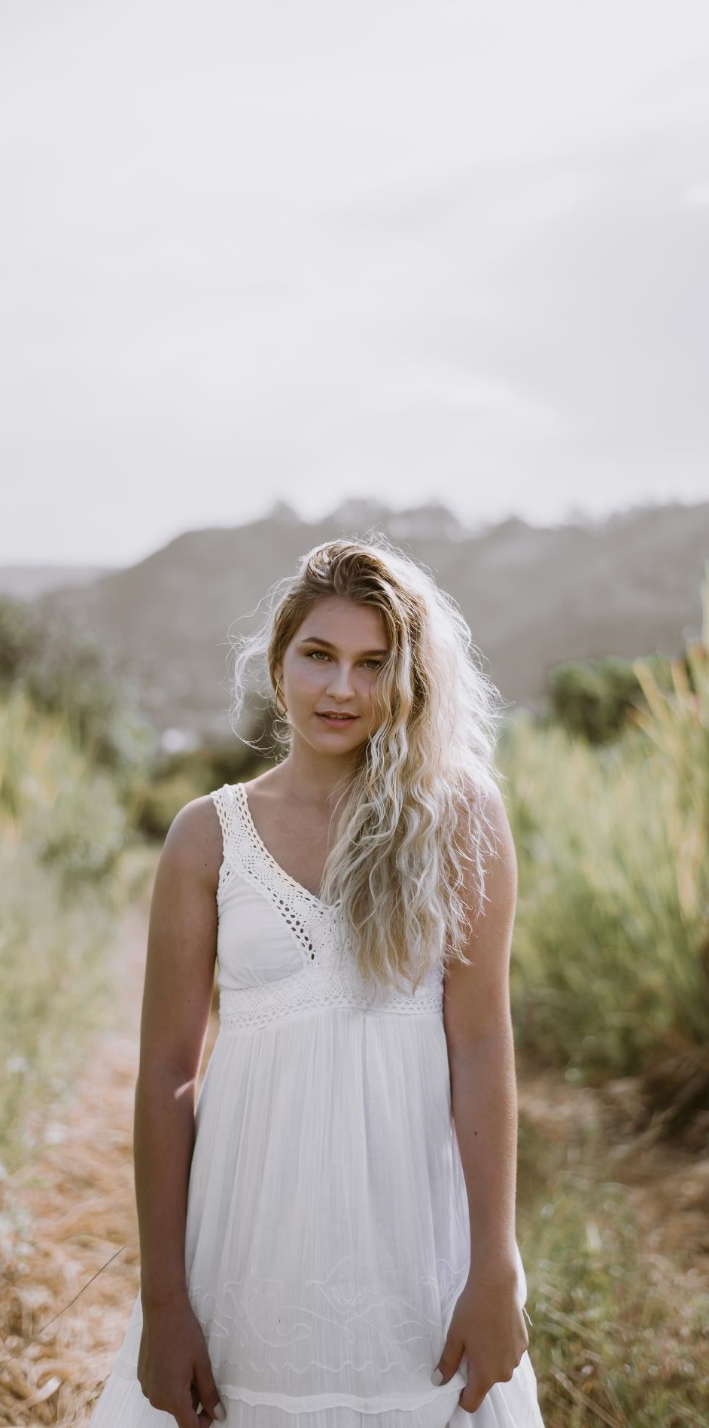
ORG
Property
Feel Display~
2020/02/20
Nearly all of the people interviewed believed that their mental illness had cost them previous job opportunities.
Your Design
Original~
Interior

Slide 5
Original
Meeting Costumer
In Pacifict Place Indor
Saturday
08:00PM
Saturday
09:00PM
Planing
Saturday
08:00PM
These employees scored lower on objective job performance evaluations than their peers.

Slide 6
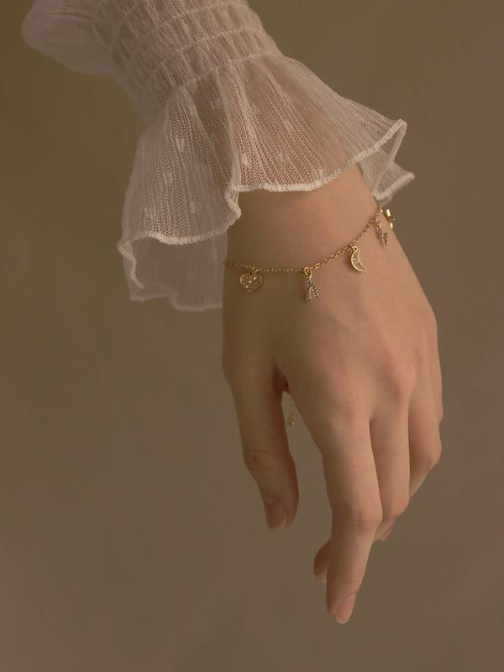
Profile
The image of the ‘tortured artist’ is a familiar characterisation that asserts that the most creative among us are bound to be touched by mental affliction.
SENG LEGOWO
Original Speaker
Designer
“
Design to enhance everyday life.
New York, 03/07/1992
Tortured artist’ is a familiar characterisation

Slide 7
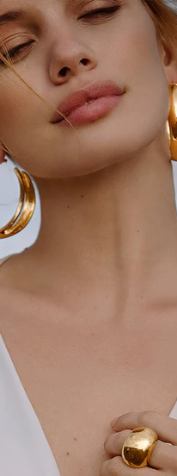
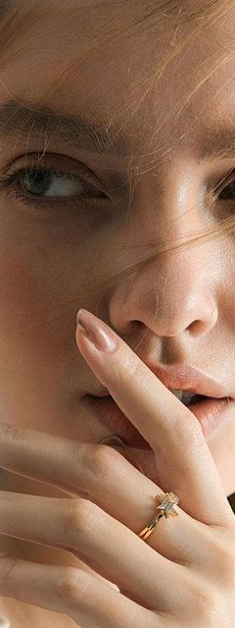
Original
Our Designer
Design to enhance everyday life.
The image of the ‘tortured artist’ is a familiar characterisation that asserts that the most creative among us are bound to be touched by mental affliction.

Slide 8
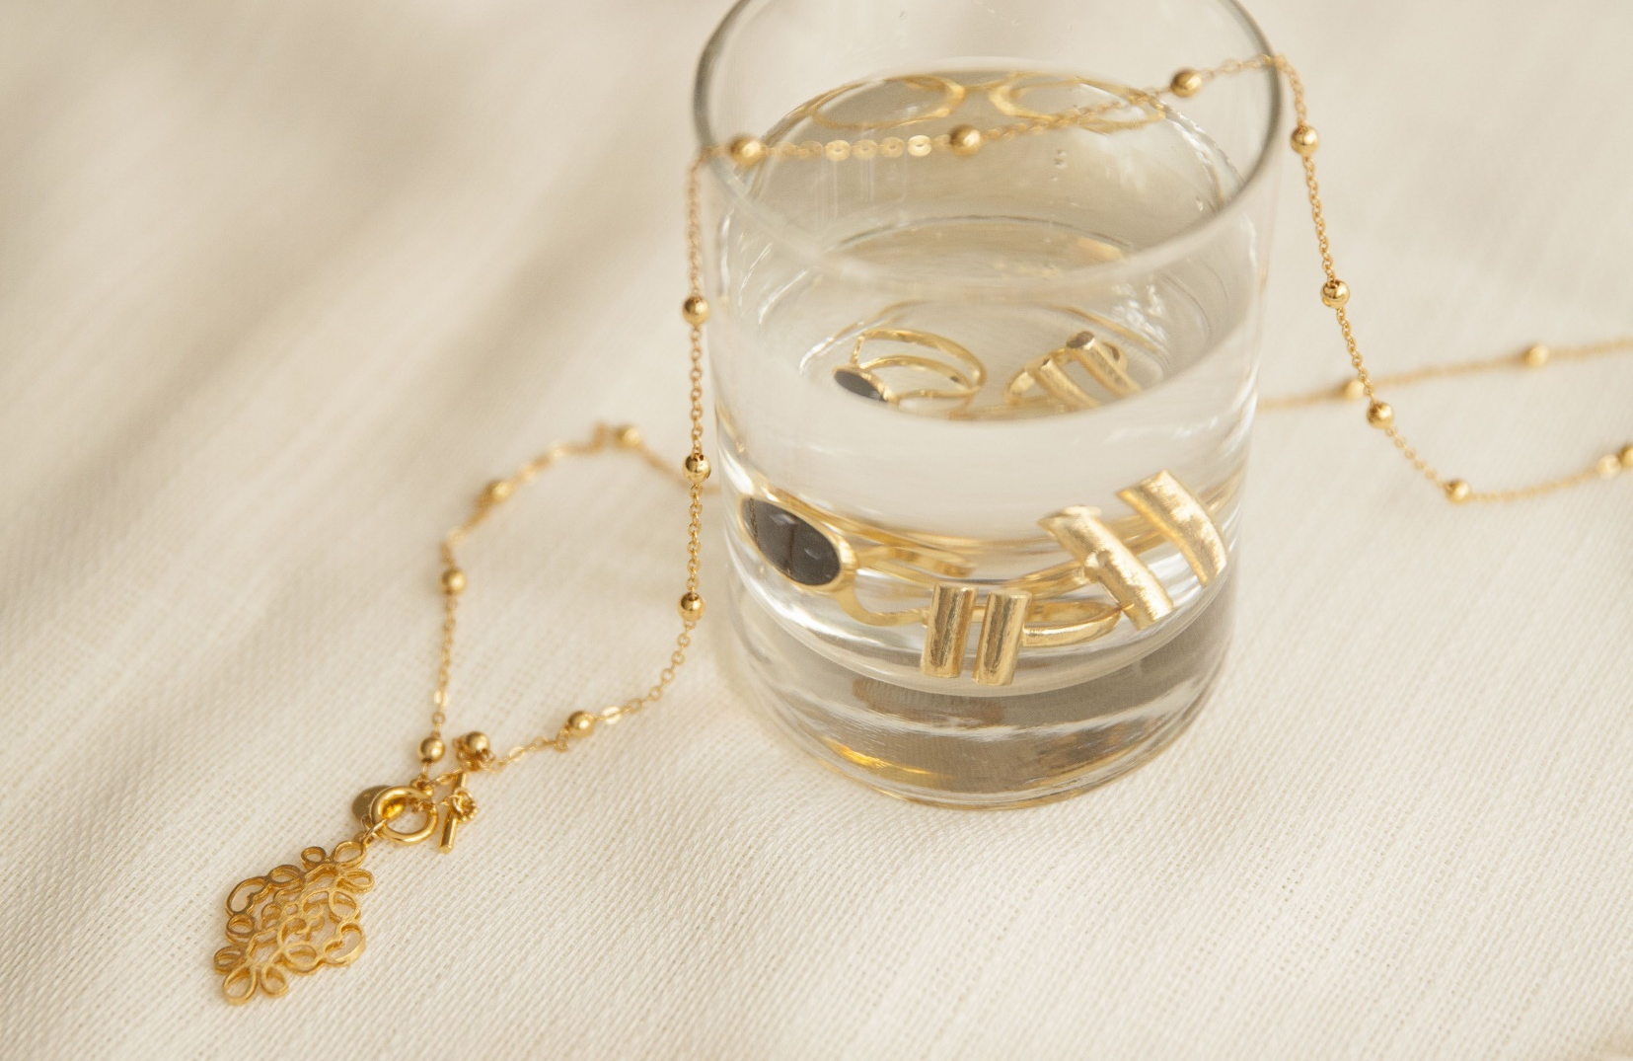
Let’s Learn How To Make It Happen/~
01
Influence behaviour
A research project I conducted on the meaning of the clothes associated with a high street brand,
02
Ultimately shape
“There is much to support the view that it is clothes that wear us, and not we, them; we may make them, take the mould of arm or breast, but they mould our hearts, our brains, our tongues to their liking.”

Slide 9
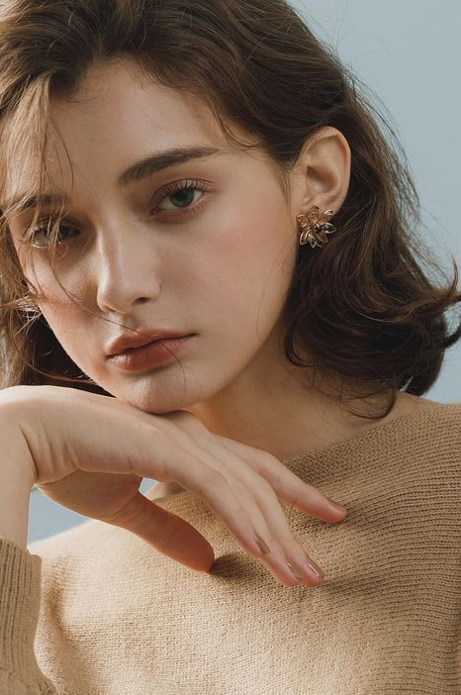
Original
A presentation template created with attentive detail to provide a new experience for users. Hopefully this presentation can help you and bring good luck to you. each of our slides is designed to make it easy for you to deliver every point of your presentation.
Potrait.
But as our (fashion) industry operates in a conventional business model that is product-driven and sales focused first, where does the value of artistic creativity stand?
Written by
Judith Achumba-
Wöllenstein

Slide 10
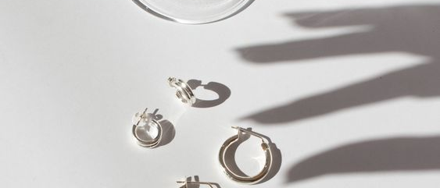
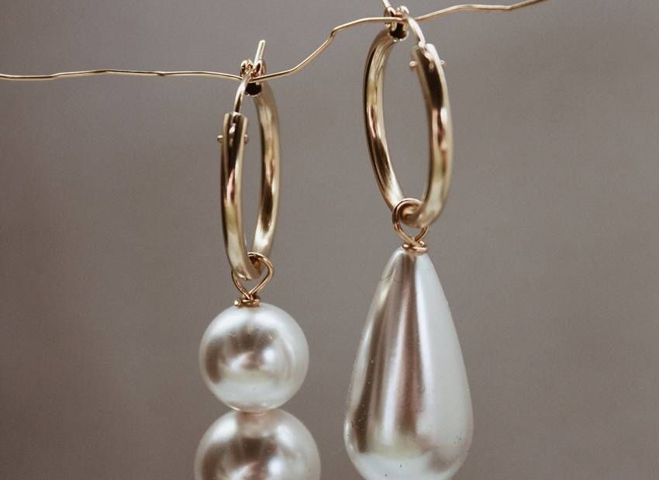
Design to enhance everyday life.
This priority.
Professionals,
It is evident in the way artists help us interpret social justice, and even the way we consume technological innovations and how these have integrated into our everyday lives.

Slide 11
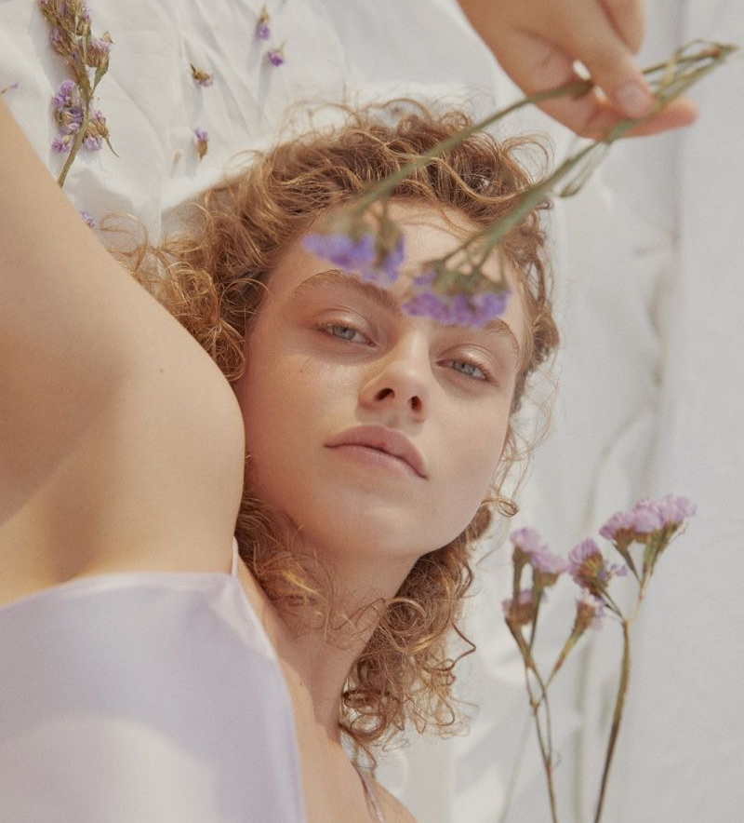
Professionals, This Priority
1.526.125+
Following your artwork.
Intrigued by current political affairs around the conduct of american police officers towards black men, researchers at a canadian university conducted a study, in which students wore police-style uniforms.r
Display

Slide 12
Use color
Pallate
#1, Cool Company #2 and Cool Company #3].
Original
A presentation template created with attentive detail to provide a new experience for users. Hopefully this presentation can help you and bring good luck to you. each of our slides is designed to make it easy for you to deliver every point of your presentation.
#1, Cool Company #2 and Cool Company #3].
#1, Cool Company #2 and Cool Company #3].
#1, Cool Company #2 and Cool Company #3].

Slide 13
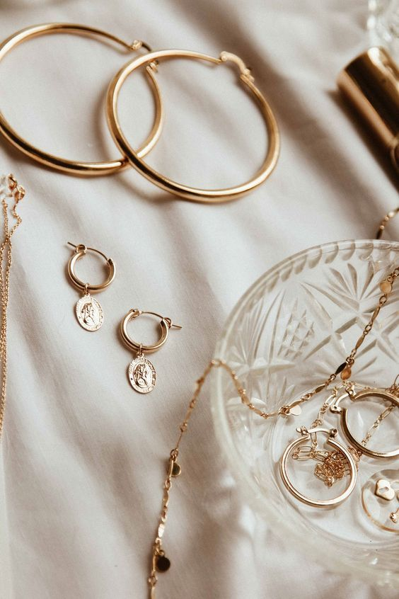
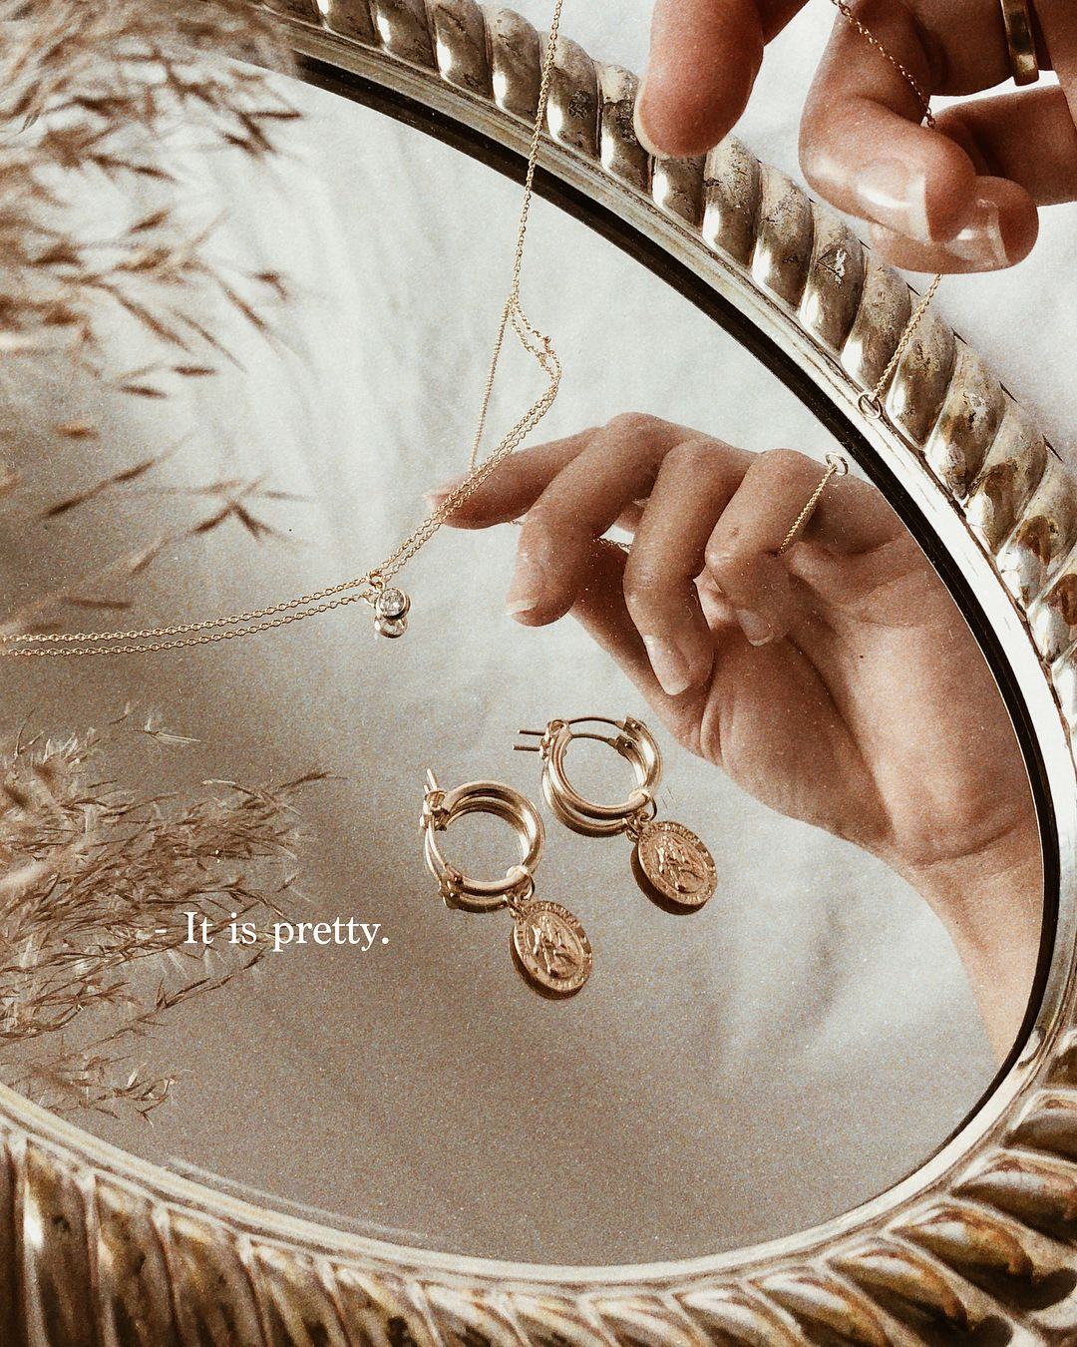
MULTIPURPOSE PRESENTATION.
Design to enhance everyday life.
[Me/Co-founder/Other Significant Employee] had a major life event — [Wedding/Baby/Marathon]

Slide 14
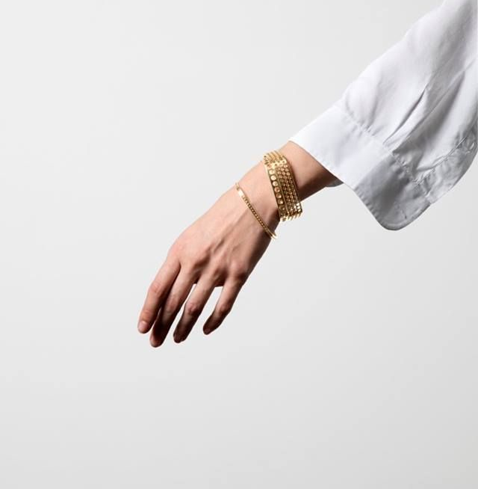
Natural
Atmosphere
Origal Design
We are very grateful to you for using our template. we keep releasing new templates every week, if you need a different style for the next presentation please visit our portfolio.
$.500K,00

Slide 15
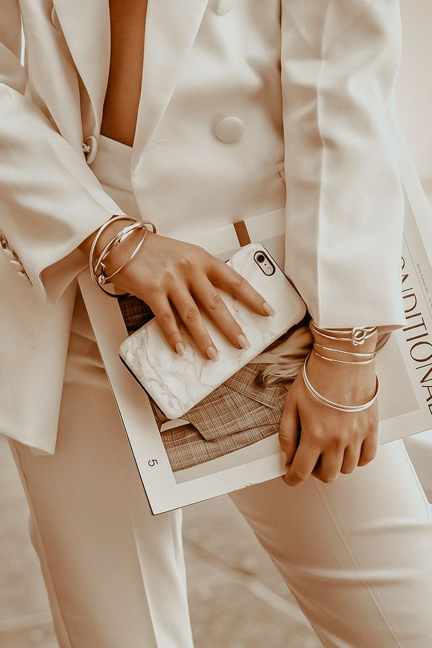
Industrial
Atmosphere
Origal Design
We are very grateful to you for using our template. we keep releasing new templates every week, if you need a different style for the next presentation please visit our portfolio.
$.000,00

Slide 16
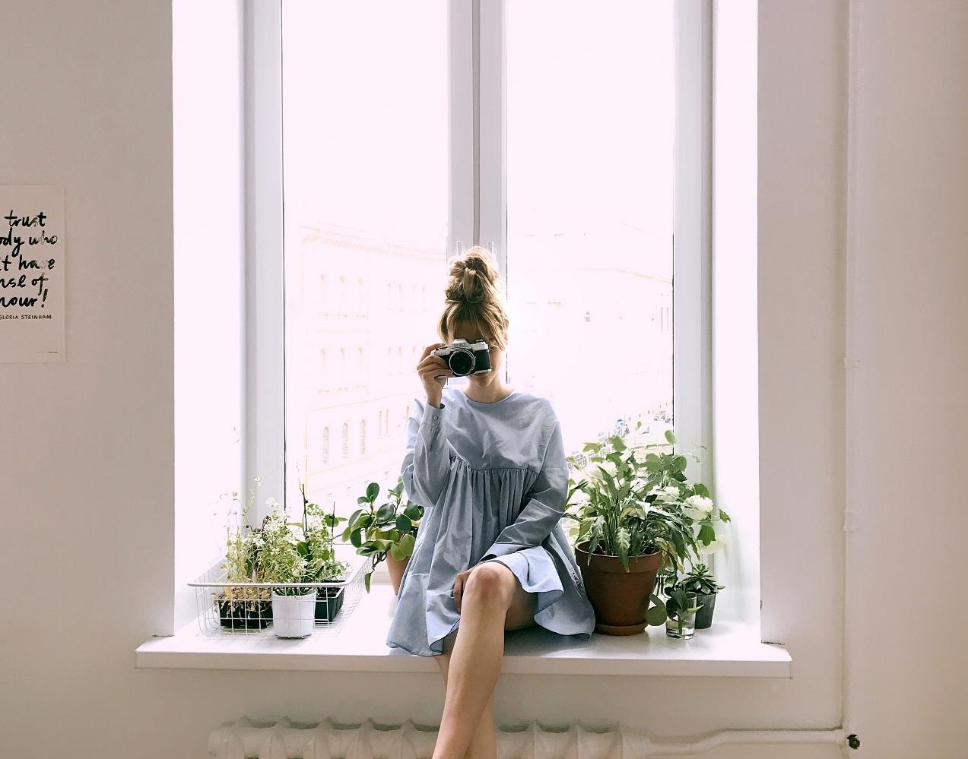
Original
MULTIPU
RPOSE PRESENTATION.
Design to enhance everyday life.
The idea that our clothes could assert some

Slide 17
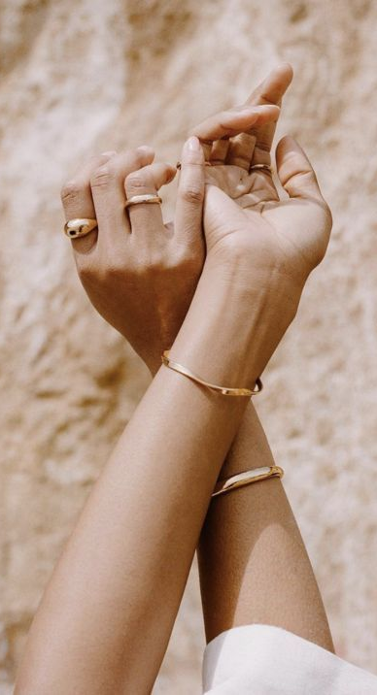
Original
Research.
A Short Point Will Look Like This Text.
Concept.
Market.
Design.
For some professionals, this priority can take its toll as it removes the heart and soul from the design process:

Slide 18
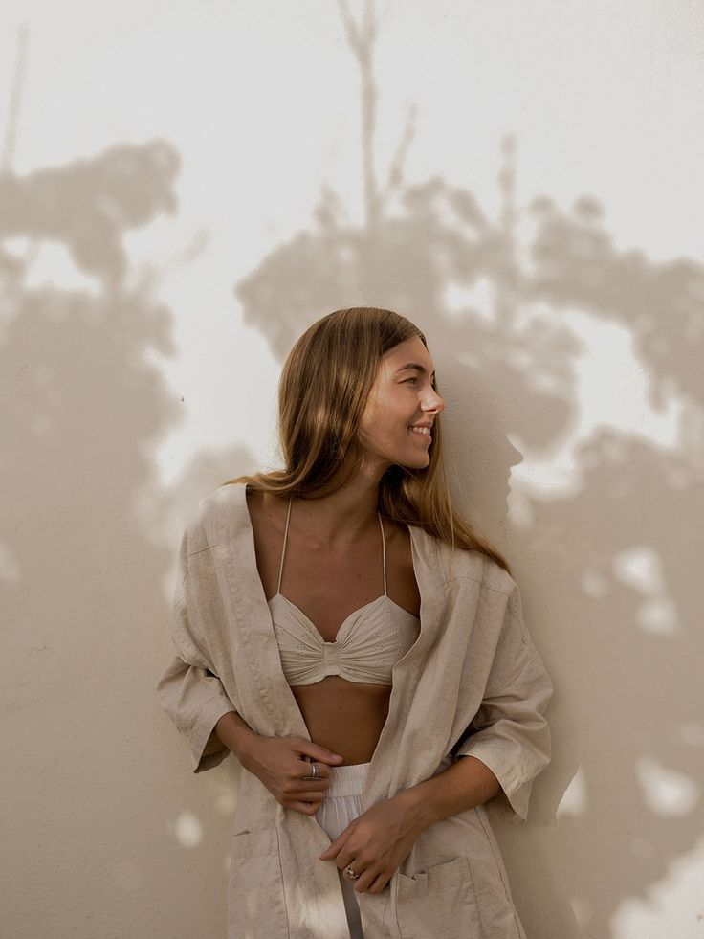

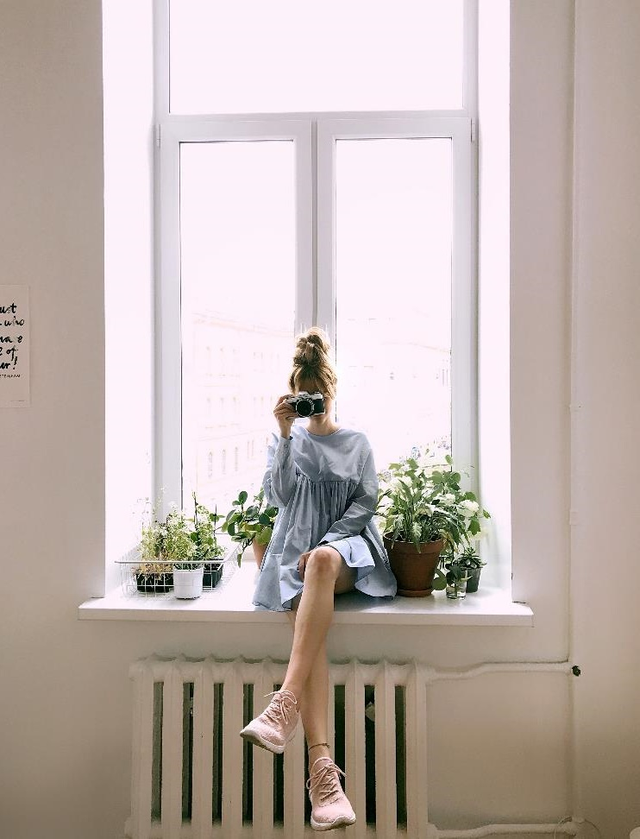
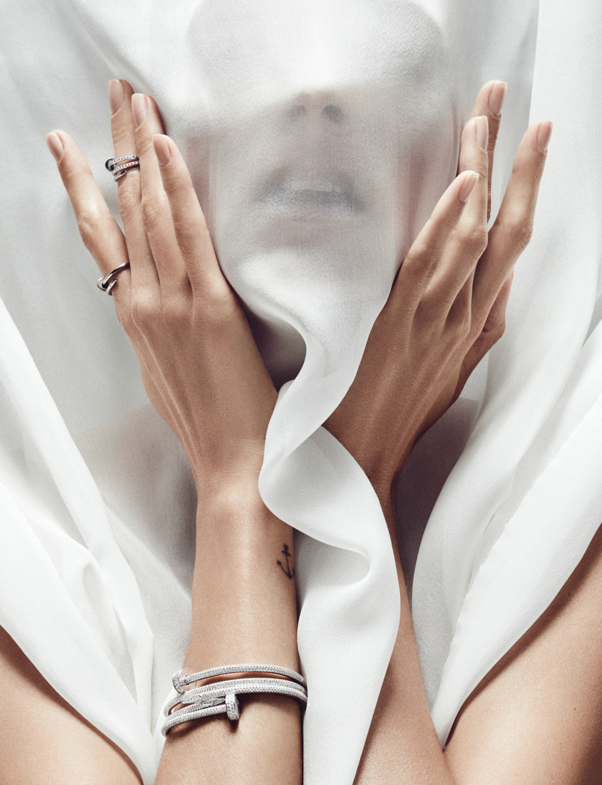
Photograph.
These employees experienced lower job satisfaction and had a negative outlook on their prospects of career progression.

Slide 19
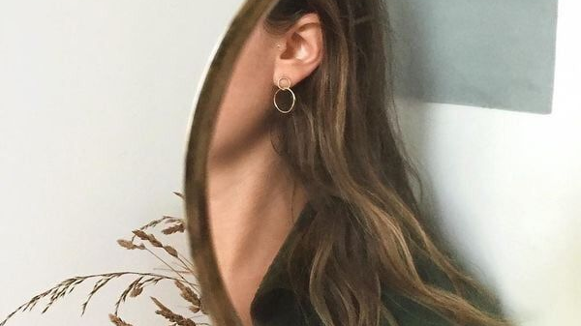
Employees scored
We Make
A Role Template
Origal Design
We are very grateful to you for using our template. we keep releasing new templates every week, if you need a different style for the next presentation please visit our portfolio.
The idea that our clothes could assert some

Slide 20
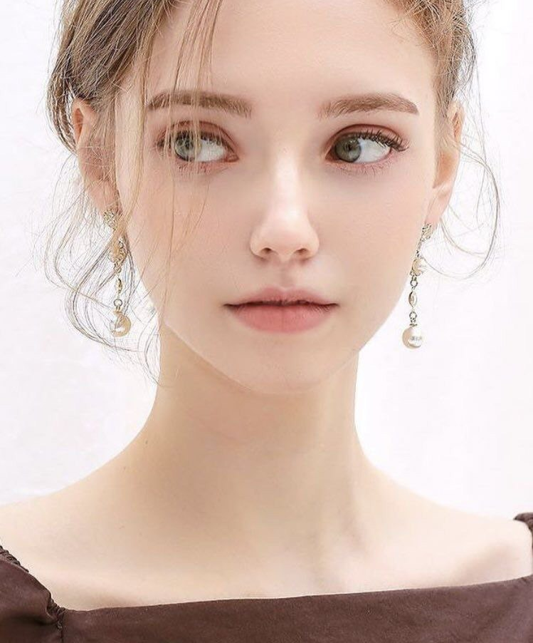
The idea that our clothes could assert some
Think Out Of The Box.
Origal Design
We are very grateful to you for using our template. we keep releasing new templates every week, if you need a different style for the next presentation please visit our portfolio.
We are very grateful to you for using our template. we keep releasing new templates every week, if you need a different style for the next presentation please visit our portfolio.

Slide 21
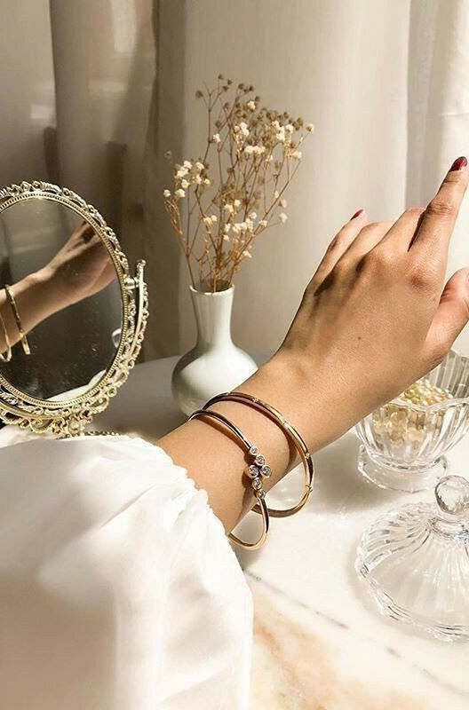
Original
Building our market.
Original
A presentation template created with attentive detail to provide a new experience for users. Hopefully this presentation can help you and bring good luck to you. each of our slides is designed to make it easy for you to deliver every point of your presentation.
Nearly all of the people interviewed believed that their mental illness had cost them previous job opportunities.

Slide 22
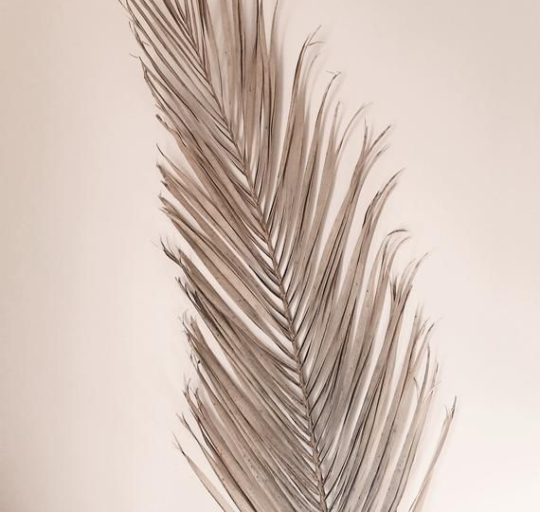
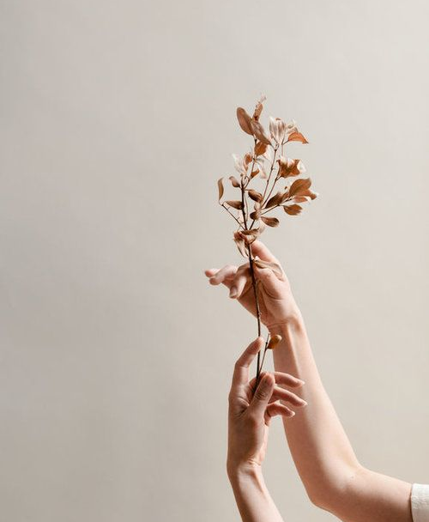
You’re a Pro. Earn money sharing your skills and experiences with businesses who need you.
Origal Design
We are very grateful to you for using our template. we keep releasing new templates every week, if you need a different style for the next presentation please visit our portfolio.
We are very grateful to you for using our template. we keep releasing new templates every week, if you need a different style for the next presentation please visit our portfolio.

Slide 23
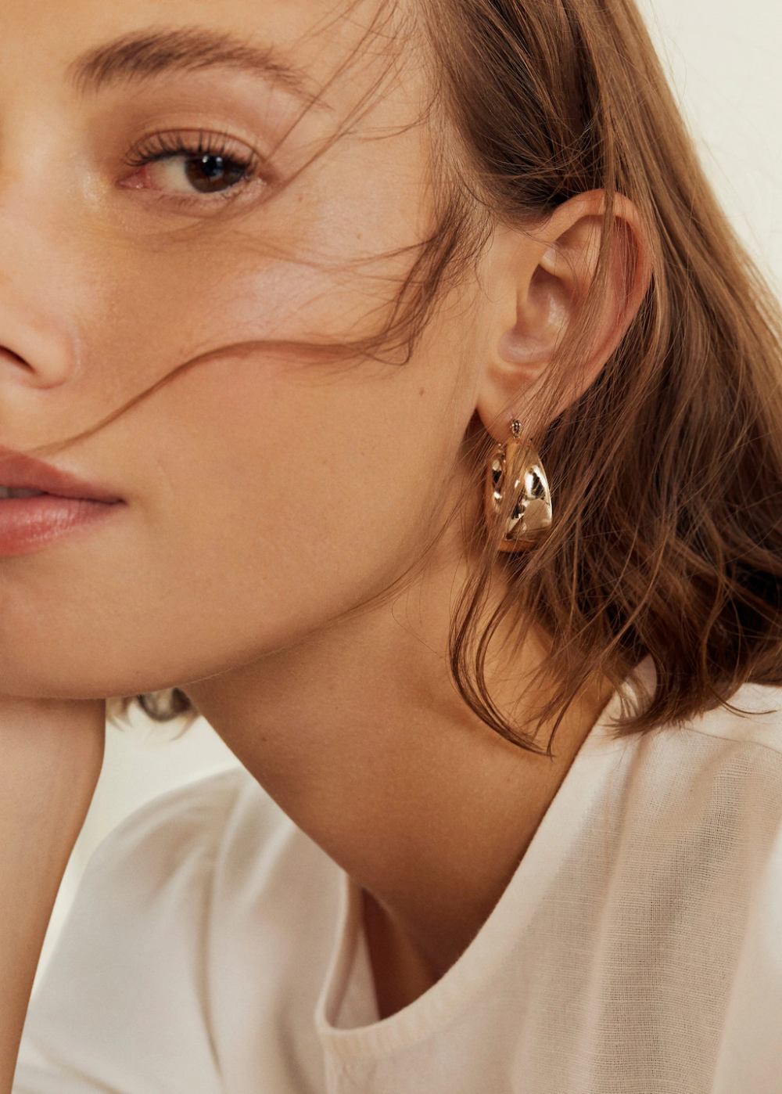
Research is confirming that clothing has the power to shape our lives.
Professionals, this priority.
In a research project I conducted on the meaning of the clothes associated with a high street brand, one of the participants described herself as being a clone of the brand, referring to the fact that she was very much aware of her likeness to other customers, who also bought the brand.
Intrigued by current political affairs around the conduct of american police officers towards black men, researchers at a canadian university conducted a study, in which students wore police-style uniforms.

Slide 24
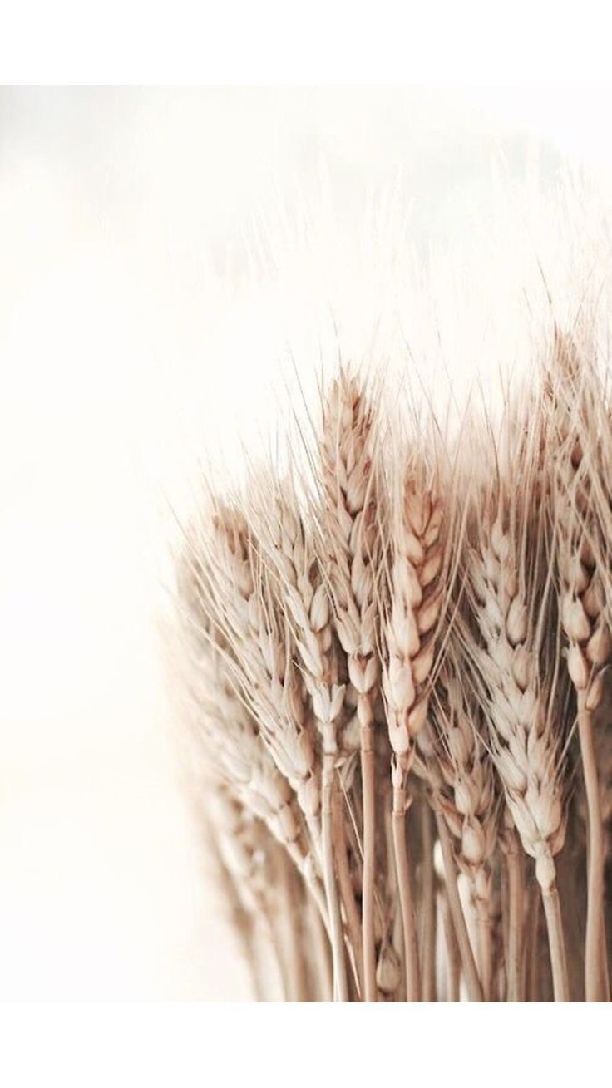
Name*
Email*
Region*
Passion*
Building our community and make it happen.
Done.

Slide 25
Most of us believe that how we dress is all about expressing to the outside who we are on the inside.
— Jess, Womenswear designer

Slide 26
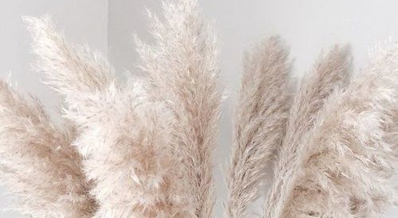
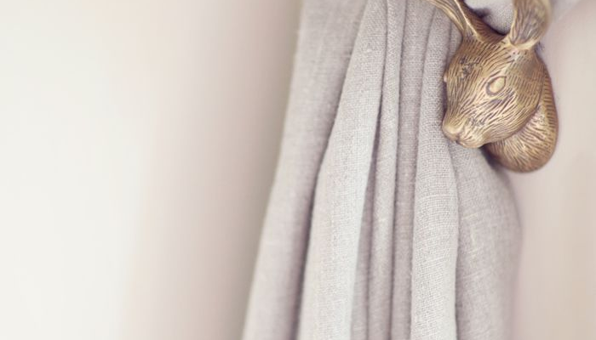
How You
See It Now?
Professionals, this priority.
In a research project I conducted on the meaning of the clothes associated with a high street brand, one of the participants described herself as being a clone of the brand, referring to the fact that she was very much aware of her likeness to other customers, who also bought the brand.
Intrigued by current political affairs around the conduct of american police officers towards black men, researchers at a canadian university conducted a study, in which students wore police-style uniforms.

Slide 27
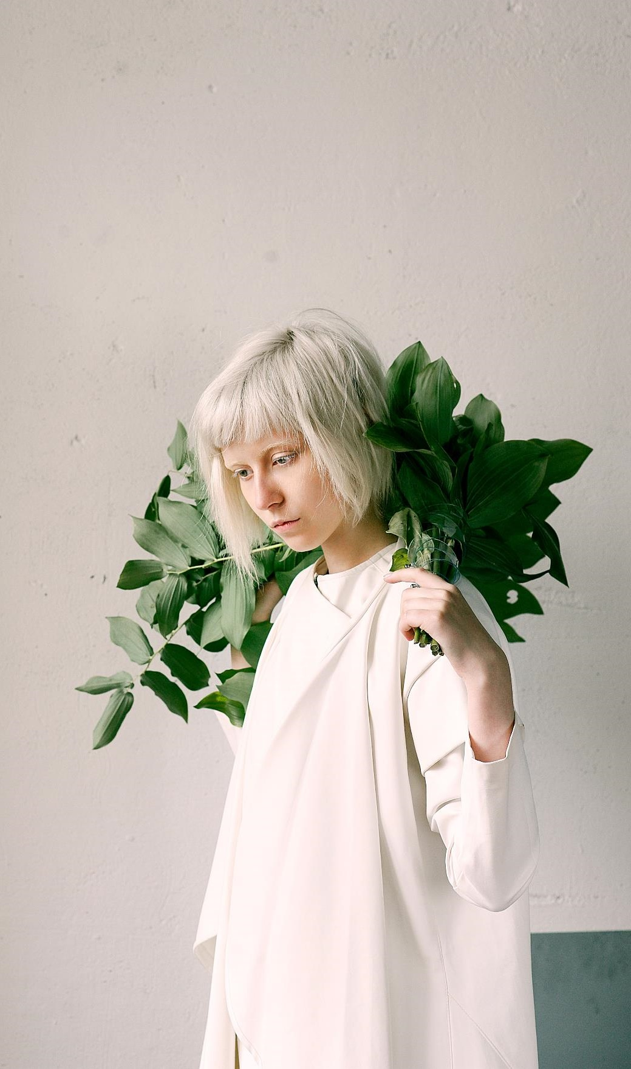
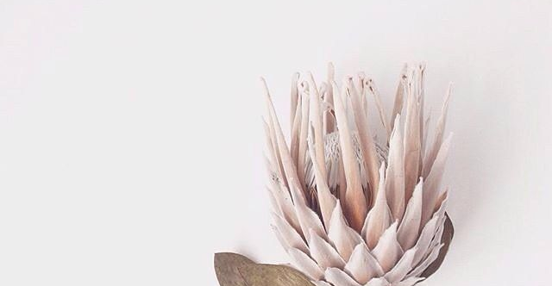
“
They often respond by explaining to me how wearing certain clothes makes them feel more confident.
Presentation Template

Slide 28
Chart Our Market Paid.
Origal Design
We are very grateful to you for using our template. we keep releasing new templates every week, if you need a different style for the next presentation please visit our portfolio.

Slide 29

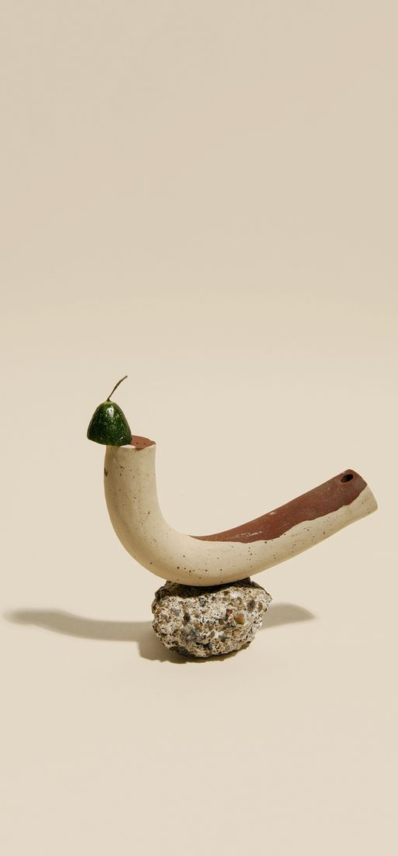
Your title here.
Steal
this
look.
We are very grateful to you for using our template. we keep releasing new templates every week, if you need a different style for the next presentation please visit our portfolio.

Slide 30
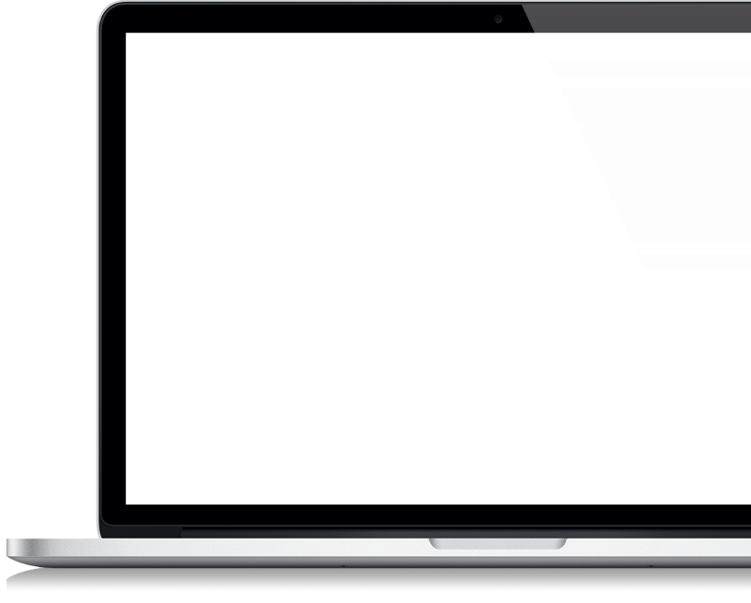
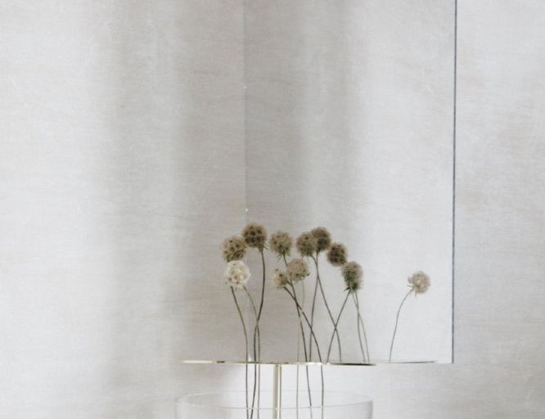
Desktop
Media
Mockup
We are very grateful to you for using our template. we keep releasing new templates every week, if you need a different style for the next presentation please visit our portfolio.

